Slide 1
Welcome to CSS 2!!
March 28, 2022

Slide 2
Today
Introductions
Course overview
Lecture & lab
Resources
Assignments & grades
Course material

Slide 3
Today
Introductions
Course overview
Lecture & lab
Resources
Assignments & grades
Course material

Slide 4
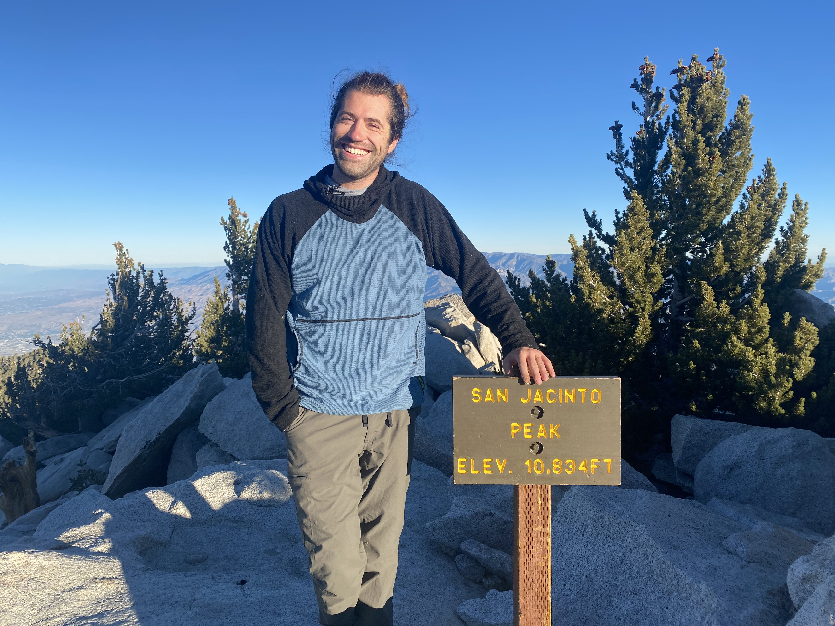
Erik Brockbank
ebrockbank@ucsd.edu
Office hours
9:00-10:00am Friday
2588 Mandler Hall
https://ucsd.zoom.us/j/7131149147
I’m here to help and support you!
Notes:
4th year PhD in psychology
computational cognition lab with Dr. Ed Vul
research focuses on building computational models of how people learn, especially the things we learn about other people!
Love San Diego: free time == surfing, hiking, running
Passionate about teaching people to code!
Please come to my OH

Slide 5
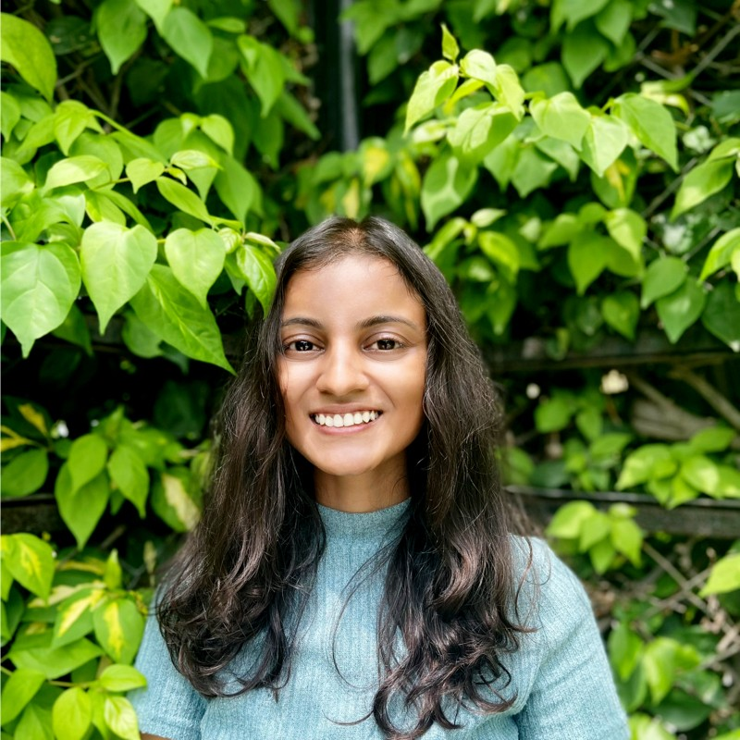
Purva Kothari
pukothar@ucsd.edu
Office hours
10:00-11:00am Wednesday
1507 Mandler Hall
https://ucsd.zoom.us/j/93025194368
Notes:
Purva is our rock star TA!
Many of you had Purva as your CSS I TA last quarter.
This week: OH from 12-1pm *today* in 2588 Mandler. Future weeks TBD.

Slide 6
Who are you?
Name
Year and Major
Something you’re passionate about or like to do in spare time

Slide 7
Today
Introductions
Course overview
Lecture & lab
Resources
Assignments & grades
Course material

Slide 8
Course Overview
Lectures:
M / W / F, 8:00-8:50am
CENTR 222
Lab:
M, 11:00-11:50am
W, 9:00-9:50am
ERCA 117
Notes:
Lectures: you all made it here so you probably know this already…
Lab: can attend either lab, but would be best if you chose one and stuck to it; lots of group work, get comfortable helping each other, asking for help, etc.
If you can’t make it on a given week, you can go to the other one instead

Slide 9

Course Overview
This class is going to be an in-person adventure!
Notes:
In person
Teaching over zoom is really hard
Learning over zoom is really hard
This material is really hard: I want to give all of you every advantage and tool to succeed, and in-person instruction/participation is one of those

Slide 10
Course Overview
This class is going to be an in-person adventure!
If you need to miss a lab or lecture, shoot me an email ahead of time so we can figure out how to keep you on track!
Notes:
The motivation for asking you to email me ahead of time isn’t to punish you
It’s to make sure that you don’t fall behind!

Slide 11
Course Overview
This class is going to be an in-person adventure!
My commitments to you:
Health and safety come first
We will stay up to date with the latest UCSD policies
I will do everything I can to make this a supportive and successful learning environment!
Notes:
Being in person doesn’t mean we throw out all caution. If you’re not feeling well, don’t come in!
We’ll continue to follow guidelines issued by the university, our academic departments, and the state of CA
I know that asking you to come in is me asking something of you; what I’ll do for you is everything I can to make this a supportive, positive, and successful learning environment
[PAUSE]

Slide 12
Today
Introductions
Course overview
Lecture & lab
Resources
Assignments & grades
Course material

Slide 13
Course Overview
Resources

Slide 14
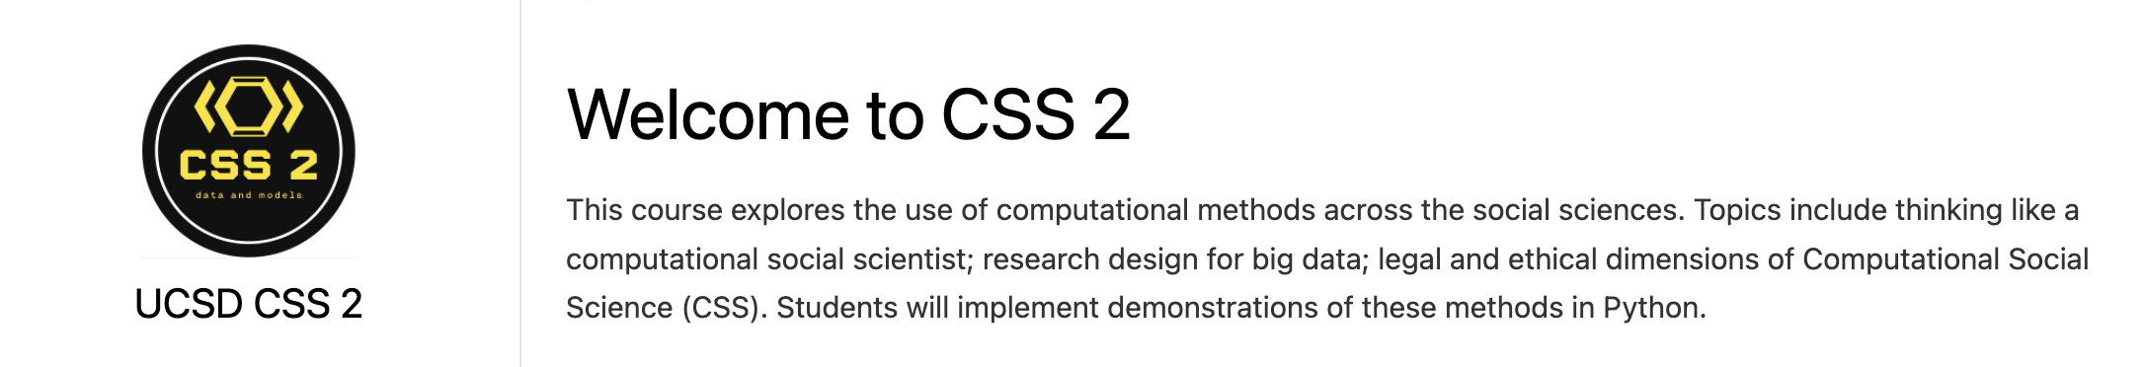
Course Overview
Resources
Course website: https://ucsd-css-002.github.io
📅 View syllabus, class schedule, policies
✍️ Download lecture notes, access other resources
Notes:
Note, this page will change throughout the quarter!
If you have a question about the course, start by going here.

Slide 15
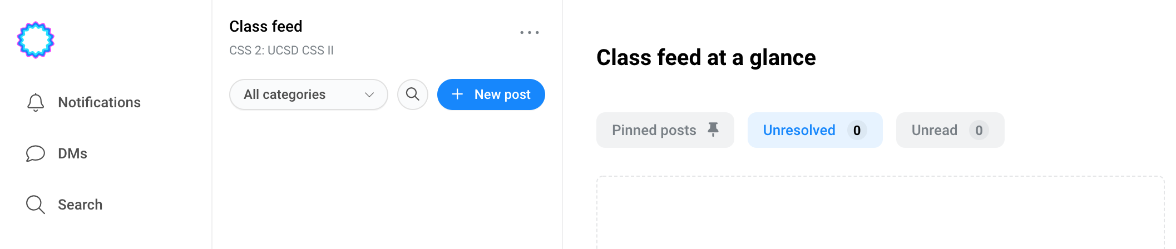
Course Overview
Resources
Campuswire: https://campuswire.com/p/GAEAAD197
Use code 2109 to join the course
🙋‍♀️ Ask questions about homework or labs
👋 View other students’ questions and the answers they got
💪 Lend a hand by answering other students’ questions!
Notes:
This is where all conversation about course material is going to happen!
Please no emails.
You can ask questions anonymously.
You can also DM me and/or Purva, but please *only* do this if there are sensitive personal aspects of your question.
If it’s a question about course content, please post so everyone can see and upvote.

Slide 16
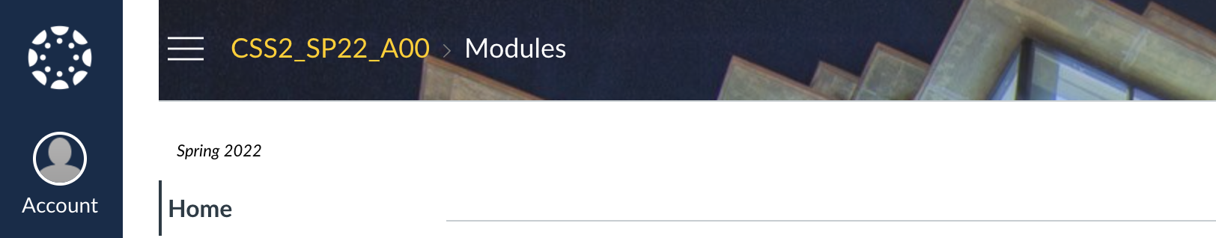
Course Overview
Resources
Canvas: https://canvas.ucsd.edu/courses/36054
💡 View grades
Notes:
Right now the plan is only to use canvas for grades.

Slide 17
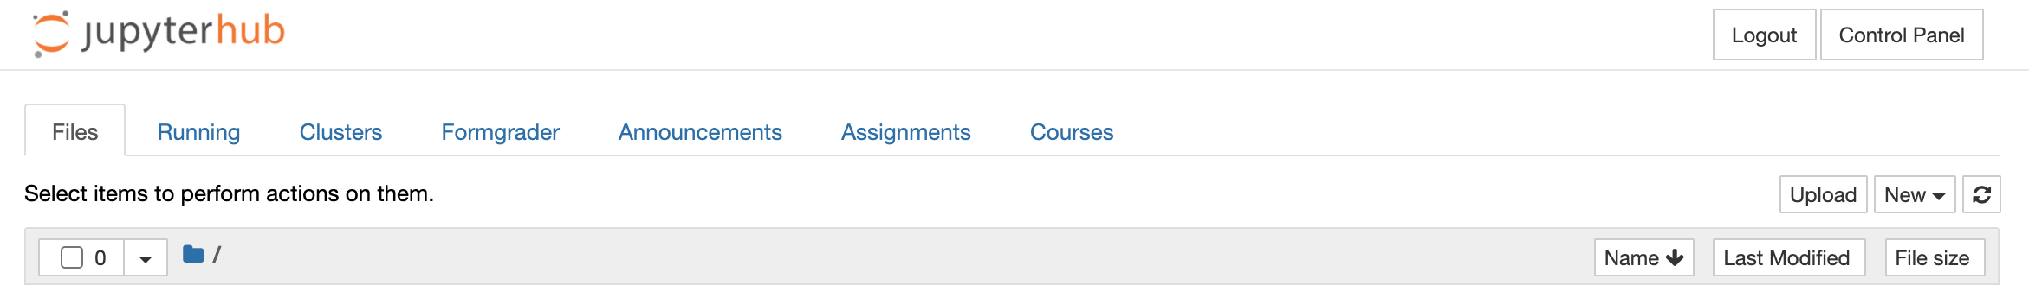
Course Overview
Resources
Datahub: https://datahub.ucsd.edu/
⌨️ View, work on, and submit problem sets and labs
🤖 Create new jupyter notebook files for taking notes
💯 View feedback from graded problem sets and labs
Notes:
Datahub: so cool, very important for this class.
CSS I students should be familiar with it already.
You should be able to log onto datahub with your UCSD credentials.
There are instructions for doing this on the course homepage.
[PAUSE]

Slide 18
Today
Introductions
Course overview
Lecture & lab
Resources
Assignments & grades
Course material

Slide 19
Course Overview
Grades

Slide 20
Course Overview
Grades
40% weekly problem sets (weeks 2-9)
35% weekly lab exercises (weeks 1-10)
15% final project
10% participation
Notes:
A typical week:
Go to lecture, learn some new content from me. See demonstrations, code along with me. Ask questions!
Go to lab, practice the things you learned in the previous week with other students. Collaborative setting. Turn in a lab exercise at the end.
Work on a problem set that challenges you to use the material from the previous week. Independent.
Meet with your final project group outside of class to make some progress on your final project.
Come to office hours to talk about problem sets or your final project (or anything else!)

Slide 21
Course Overview
Grades
40% weekly problem sets (weeks 2-9)
35% weekly lab exercises (weeks 1-10)
15% final project
10% participation

Slide 22
Course Overview
Problem sets and labs
Hosted on UCSD datahub
See https://ucsd-css-002.github.io/course/datahub.html

Slide 23
Course Overview
Problem sets and labs
Hosted on UCSD datahub
See https://ucsd-css-002.github.io/course/datahub.html
Labs
Group work meant to be finished during the lab
Due one week after lab in case you need more time to finish
Purpose: practice the things demonstrated in lecture, teach and learn from your classmates (and Purva!)

Slide 24
Course Overview
Problem sets and labs
Hosted on UCSD datahub
See https://ucsd-css-002.github.io/course/datahub.html
Problem sets
Individual work meant to be completed outside of class
Due every Sunday (starting in week 2)
Purpose: get comfortable doing the things you learned about in lecture and lab on your own
Notes:
[PAUSE]

Slide 25
Course Overview
Grades
40% weekly problem sets (weeks 2-9)
35% weekly lab exercises (weeks 1-10)
15% final project
10% participation

Slide 26
Course Overview
Final project
See https://ucsd-css-002.github.io/course/final.html
Task: complete a large, well-motivated analysis of real-world data
Notes:
What do I mean by each of those?
Large: will require combining things you learn throughout the quarter
Well-motivated: like data science in the real world, should try to answer an interesting question or present an interesting result
Real-world: will use actual data, in some cases quite large

Slide 27
Course Overview
Final project
See https://ucsd-css-002.github.io/course/final.html
Task: complete a large, well-motivated analysis of real-world data
Setup: work with a group of ~5 people
Notes:
Group work: most professional data science work is done in groups
This lets you be more ambitious!

Slide 28
Course Overview
Final project
See https://ucsd-css-002.github.io/course/final.html
Task: complete a large, well-motivated analysis of real-world data
Setup: work with a group of ~5 people
Deliverable: a jupyter notebook with (a) a summary of your data incl. cleaning and formatting steps, (b) graphs showing key patterns in your data, (c) modeling and analysis of your data

Slide 29
Course Overview
Final project
See https://ucsd-css-002.github.io/course/final.html
Task: complete a large, well-motivated analysis of real-world data
Setup: work with a group of ~5 people
Deliverable: a jupyter notebook with (a) a summary of your data incl. cleaning and formatting steps, (b) graphs showing key patterns in your data, (c) modeling and analysis of your data
Goal: Use the tools we learn about in this class to explore patterns in a large, publicly available data set

Slide 30
Course Overview
Final project
See https://ucsd-css-002.github.io/course/final.html
Task: complete a large, well-motivated analysis of real-world data
Setup: work with a group of ~5 people
Deliverable: a jupyter notebook with (a) a summary of your data incl. cleaning and formatting steps, (b) graphs showing key patterns in your data, (c) modeling and analysis of your data
Goal: Use the tools we learn about in this class to explore patterns in a large, publicly available data set
Present in lab on 6/1, turn in final version by 6/8
Notes:
NOTE 5/30 holiday so everyone should come to the 6/1 lab for this (email if that doesn’t work with your schedule)
Will see everybody’s presentation, give feedback that you can use to revise before it’s due.

Slide 31
Course Overview
Grades
40% weekly problem sets (weeks 2-9)
35% weekly lab exercises (weeks 1-10)
15% final project
10% participation
If you come to class and lab, do your best to answer questions, and ask if you’re confused, you will get full participation points!
Notes:
If I or Purva are concerned about any of you not getting these points, I’ll reach out to you to find out how we can make sure you’re involved.
If talking in class isn’t your style, helping on campuswire is great too!
[PAUSE]

Slide 32
Today
Introductions
Course overview
Lecture & lab
Resources
Assignments & grades
Course material

Slide 33
Course Overview
Material
See https://ucsd-css-002.github.io/course/syllabus.html

Slide 34
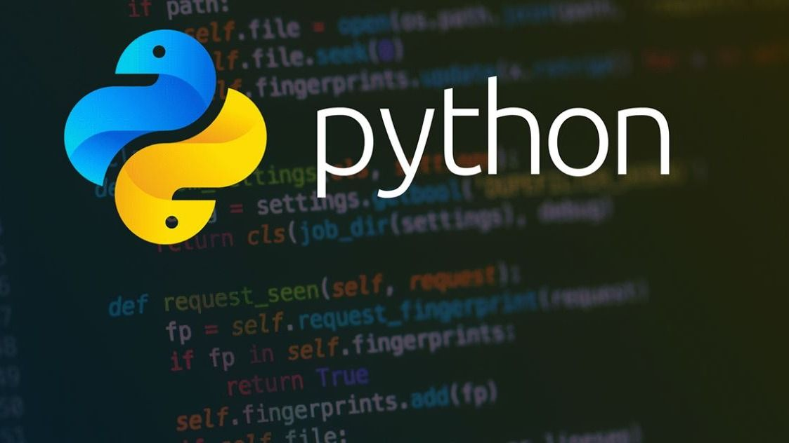
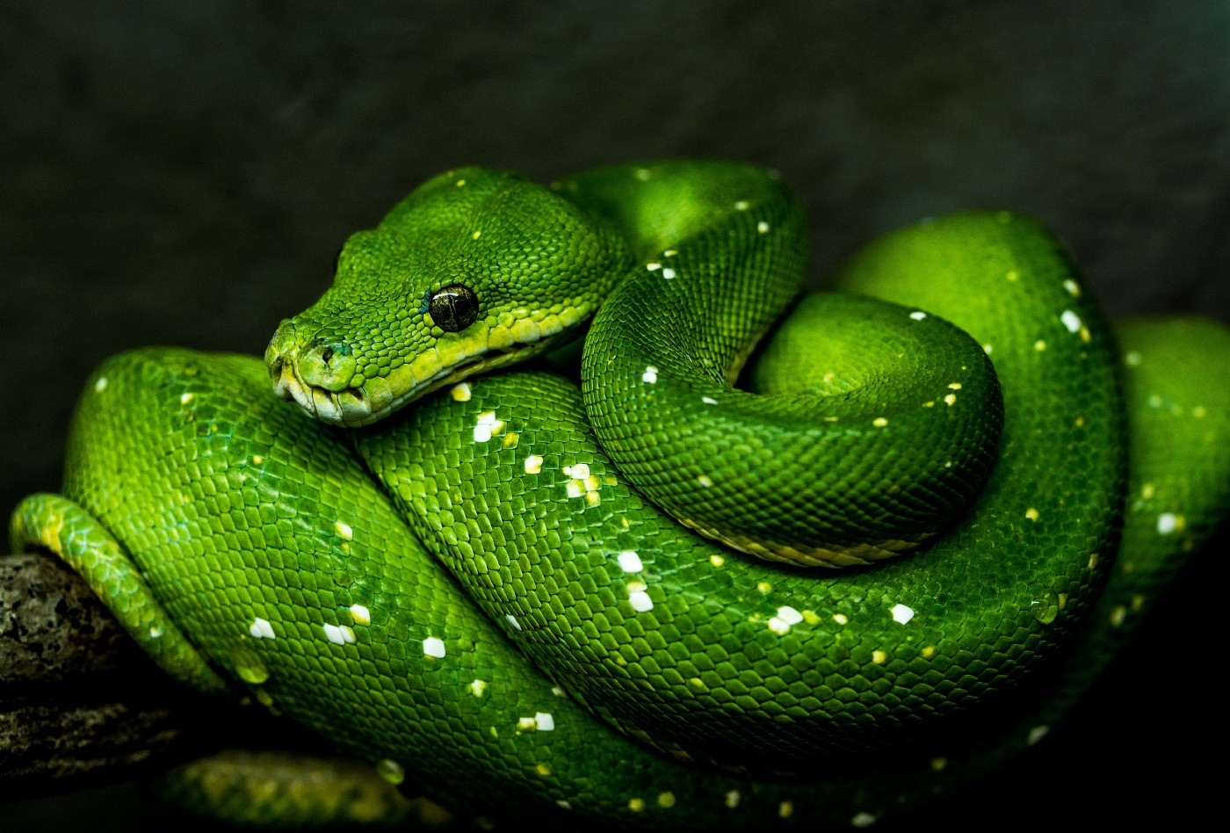
Course Overview
Material
See https://ucsd-css-002.github.io/course/syllabus.html
Week 1
Python review
IMPORTANT: if you’re struggling with the review material this week, we will need to figure out how to get you up to speed!
Notes:
We’ll talk about basic syntax and data structures, then we’ll remember how to write functions and do a very high-level overview of how to write classes.
For those of you who just took CSS I or another python based class, this should be pretty comfortable.
If any of the material this week *isn’t* comfortable, it’s super important that you come talk to me or Purva so we can get you the resources you need to be all caught up.
I can’t emphasize this enough: throughout this course, the coding may be really challenging so if you’re feeling overwhelmed by it, come to office hours or reach out.

Slide 35


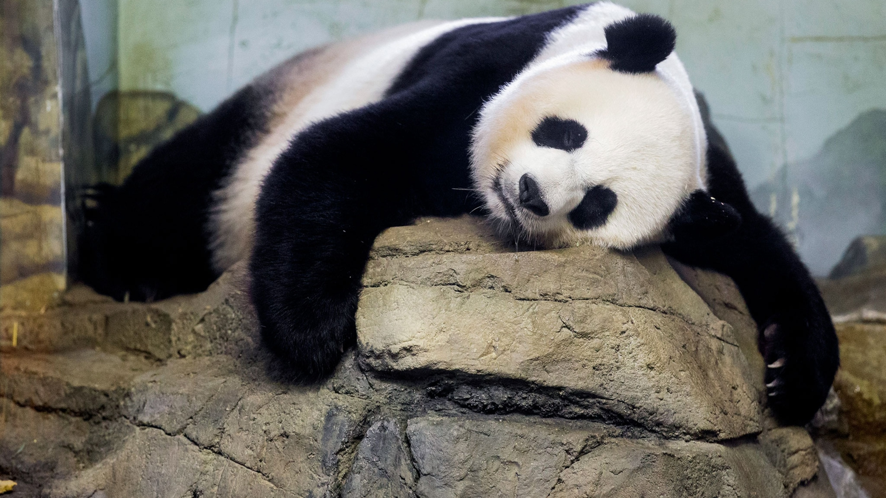
Course Overview
Material
See https://ucsd-css-002.github.io/course/syllabus.html
Week 2
Python tools for doing data science
numpy
pandas
Notes:
This is also likely to be a review of CSS I content, but it’s a chance to get more comfortable with this material.

Slide 36
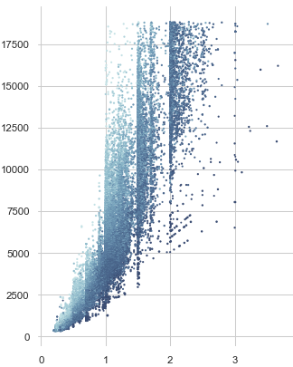

Course Overview
Material
See https://ucsd-css-002.github.io/course/syllabus.html
Week 3
Python tools for graphing data
matplotlib
seaborn
NOTE: in week 3 we will have two guest lectures and one recorded lecture so things may be a little hectic!

Slide 37

Course Overview
Material
See https://ucsd-css-002.github.io/course/syllabus.html
Week 4
Python data modeling fundamentals
cleaning and structuring your data
formatting and processing your data

Slide 38
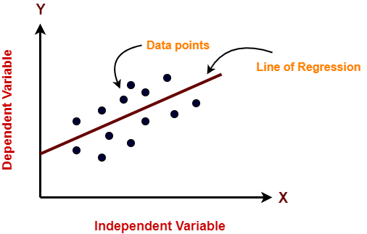
Course Overview
Material
See https://ucsd-css-002.github.io/course/syllabus.html
Week 5
Using models to make predictions
linear regression and friends
Notes:
So the course is kind of divided into two halves.
The first four weeks or so of the quarter are going to be mostly about the python modeling and data science ecosystem
The second half of the course up through week 9 will then explore the kinds of modeling we can do.
The very first thing we’ll talk about is linear regression, which is kind of the bread and butter of a lot of data science and modeling work.

Slide 39

Course Overview
Material
See https://ucsd-css-002.github.io/course/syllabus.html
Week 6
Using models to perform classification
k-nearest neighbors, logistic regression, and friends
Notes:
Then we’ll talk about “classification problems”, which are a large set of problems in data science and CSS
We’ll learn a few different solutions, how to evaluate them.

Slide 40

Course Overview
Material
See https://ucsd-css-002.github.io/course/syllabus.html
Week 7
Using models to perform classification cont’d.
Special topic: ethics in data science
Notes:
In week 7 we’ll continue talking about classification, and we’ll also have a special lecture on ethics in data science, which is an important and very hot topic right now

Slide 41
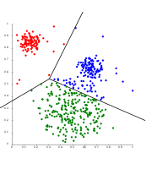
Course Overview
Material
See https://ucsd-css-002.github.io/course/syllabus.html
Week 8
Using models to perform clustering
supervised versus unsupervised modeling
k-means clustering and friends
Notes:
Then in week 8 we’ll switch over to “clustering” models, which is another large and important class of problems in data science

Slide 42

Course Overview
Material
See https://ucsd-css-002.github.io/course/syllabus.html
Week 9
Using models to perform dimensionality reduction
principal components analysis and friends
Notes:
In week 9, we’ll talk about a related topic called “dimensionality reduction”, and the models that we can use to solve this problem.

Slide 43
Course Overview
Material
See https://ucsd-css-002.github.io/course/syllabus.html
Week 10
Review
Plus work on your final projects
Notes:
Then right now I’ve left week 10 open for reviewing concepts from throughout the quarter and doing work on final projects.
If need be, we may end up pushing some of the earlier content out to week 10 as overflow.

Slide 44
Today
Introductions
Course overview
Lecture & lab
Resources
Assignments & grades
Course material
Questions?

